Slide 1
CPE 301: IMU DATA COLLECTION FOR HAND MOVEMENTS
Emmanuel Sanchez
Email: sanch512@unlv.nevada.edu

Slide 2
AIM & ACCOMPLISHMENT:
AIM:
To estimate human hand movements and determine levels of activity in workstations by monitoring and storing accelerometer/gyro data.
ACCOMPLISHMENT
Learned to capture data from gyroscope/accelerometer and use it for estimating orientation and movement of an object.
Learned to filter and display the collected data in a visual manner.
Learned to communicate wirelessly with a device using a Bluetooth module.
Learned to regulate 9V battery to 5V to power AVR.

Slide 3
requirements
Components
AVR ATMEGA328P
Gyro/Accelerometer (MPU 6050)
Bluetooth module
LM7805 – 5V voltage regulator
9V battery with connector
“Bluetooth Terminal/Graphics” Android application
Interfaces
I2C: ATMEGA328P to MPU-6050
UART + Bluetooth: ATMEGA328P to Android device

Slide 4
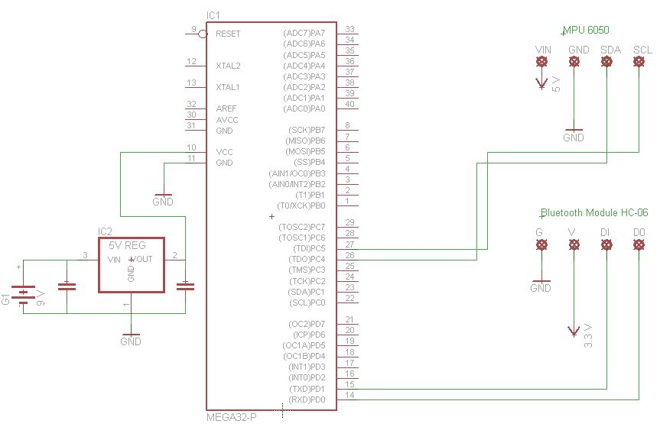
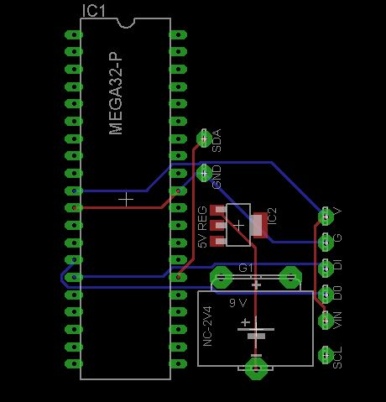
Schematics and PCB layout:

Slide 5
Project stages
Learn to collect data from gyros/accelerometers.
Make sense of the data (e.g. turn into degrees).
Use ‘complementary filter’ to de-noise data.
Make the device wireless by adding Bluetooth capability.
Graph data on android device using “Bluetooth Terminal/Graphics” application.
Make the device mobile by using battery as power supply.

Slide 6
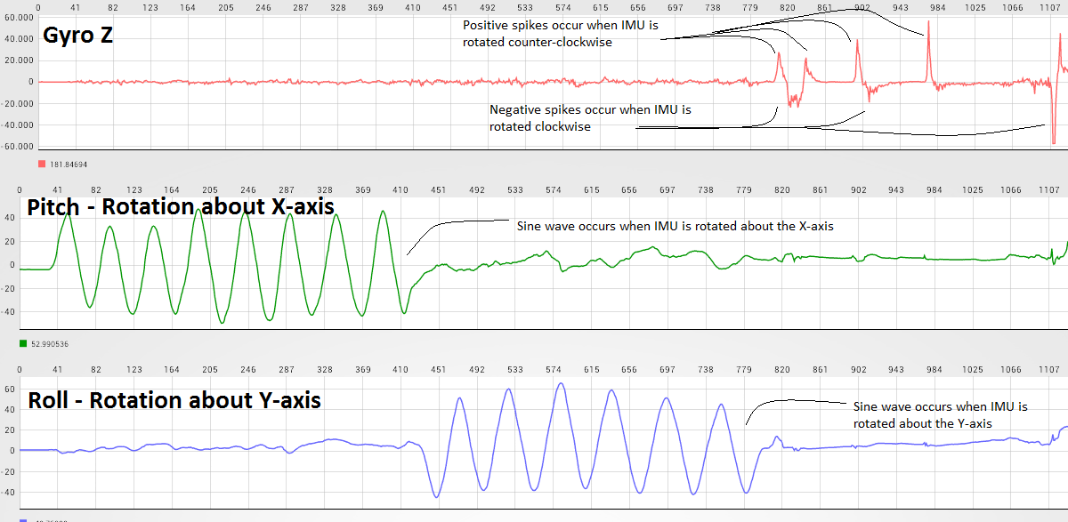
GRAPHS

Slide 7
PROGRAM DEVELOPMENT:
Uses an adaptation of the sample code that was provided at: https://github.com/YifanJiangPolyU/MPU6050
Kalman filter was replaced with complementary filter like the one found at: http://www.pieter-jan.com/node/11

Slide 8
Demo video:
https://www.youtube.com/watch?v=6fIou7R4bvI

